Slide 1
The Look Stock and Shipping
Gentur Herlambang

Slide 2
Background
A well-known online retailer called "The Look" provides clients with access to a variety of goods. We thoroughly examined the stock and shipping performance for the first and second quarters of 2023 (Q1-Q2 2023) as part of our ongoing efforts to assess and improve the company's performance. The objective of this review is to offer insightful information on the effectiveness of order processing, top shipped categories, distribution center performance, destination nations, and the relationship between gender and order cancellation. We can find areas for development and improvement by looking at these important areas.

Slide 3
Key Issues
Order Status Distribution: Evaluate order processing efficiency and identify bottlenecks affecting customer satisfaction.
Top Shipped Categories: Understand customer preferences and guide inventory planning and marketing strategies.
Distribution Center Performance: Assess fulfillment and shipping performance for each center, identifying areas for improvement.
Destination Countries: Identify top shipping destinations in Q1-Q2 2023 to uncover growth opportunities and inform expansion strategies.
Gender-based Order Cancelation: Analyze the correlation between gender and order cancelation, revealing customer behavior insights for targeted marketing.

Slide 4
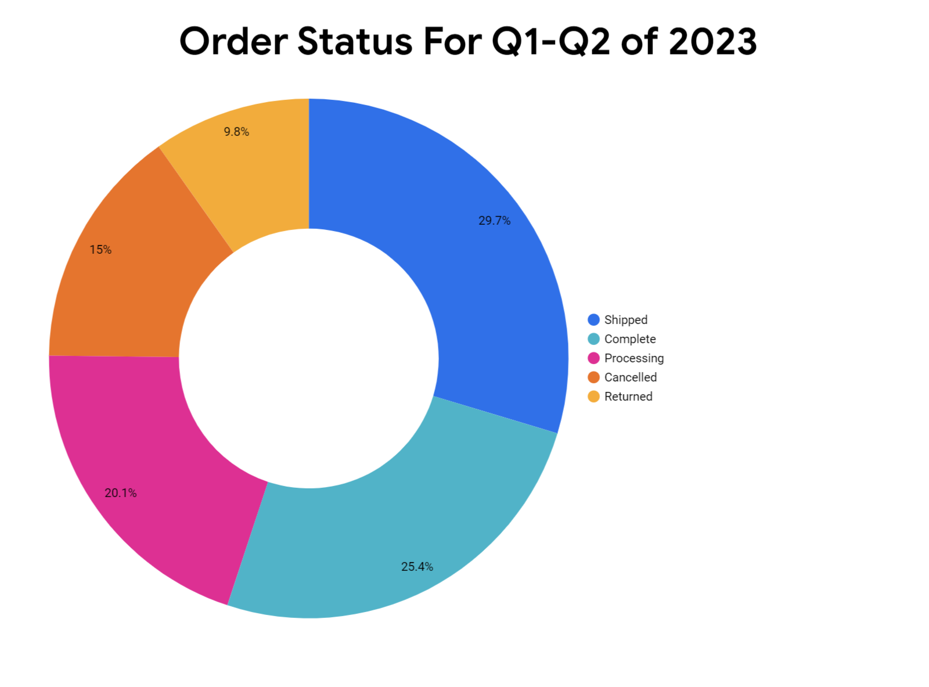
Order status
The completed shipment is around 25 % where are the returned and canceled combined is also estimated at 25%
Based on(https://clevertap.com/blog/ecommerce-return-rate-statistics/) we still bellow the 30% of the standard in the industry .

Slide 5
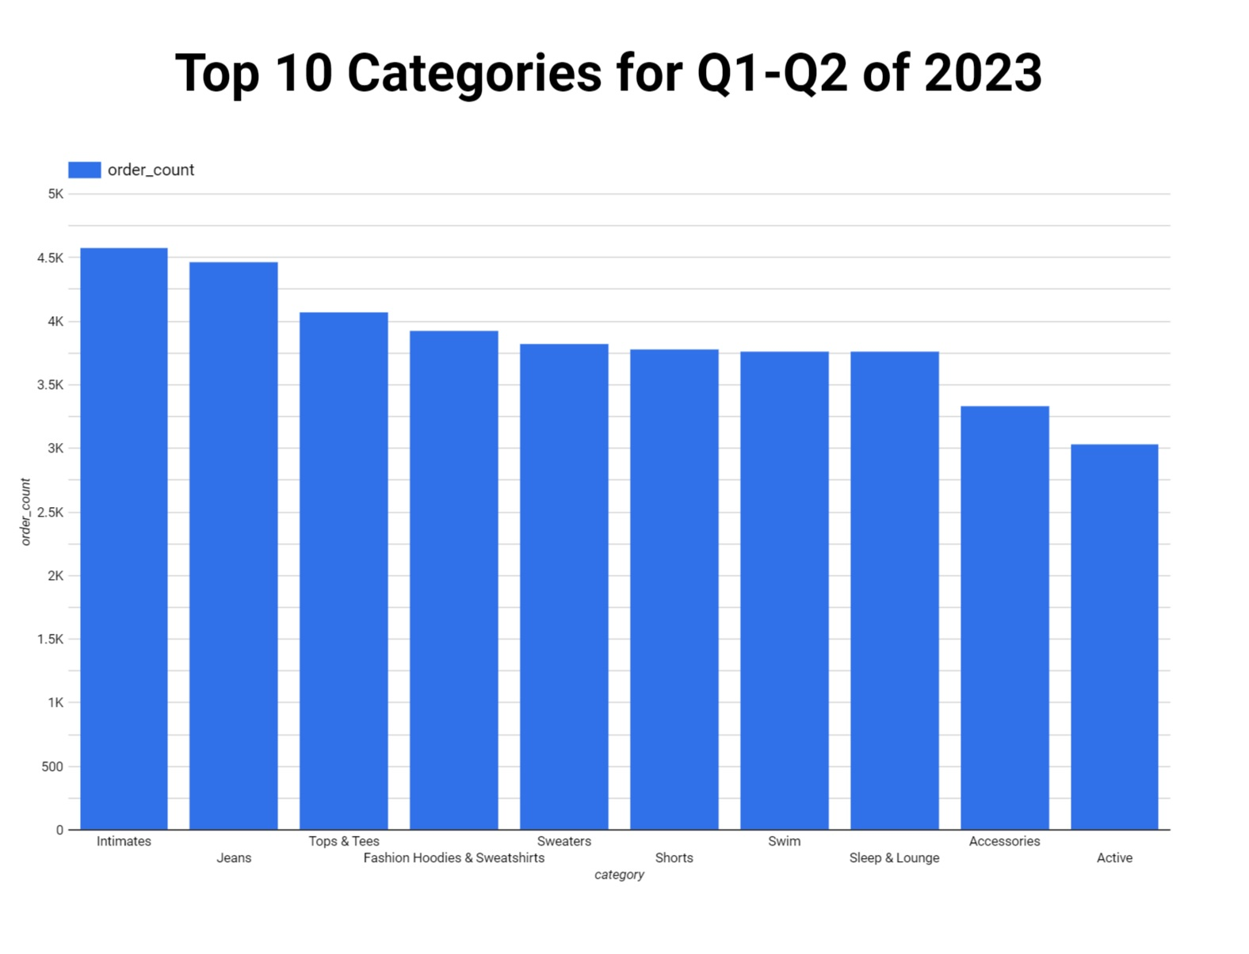
Categories
Intimate , jeans , and Tops and tees are the top three item that we shipped for the first half of 2023.
But the gap between the top 10 categories don’t show much significant difference.

Slide 6
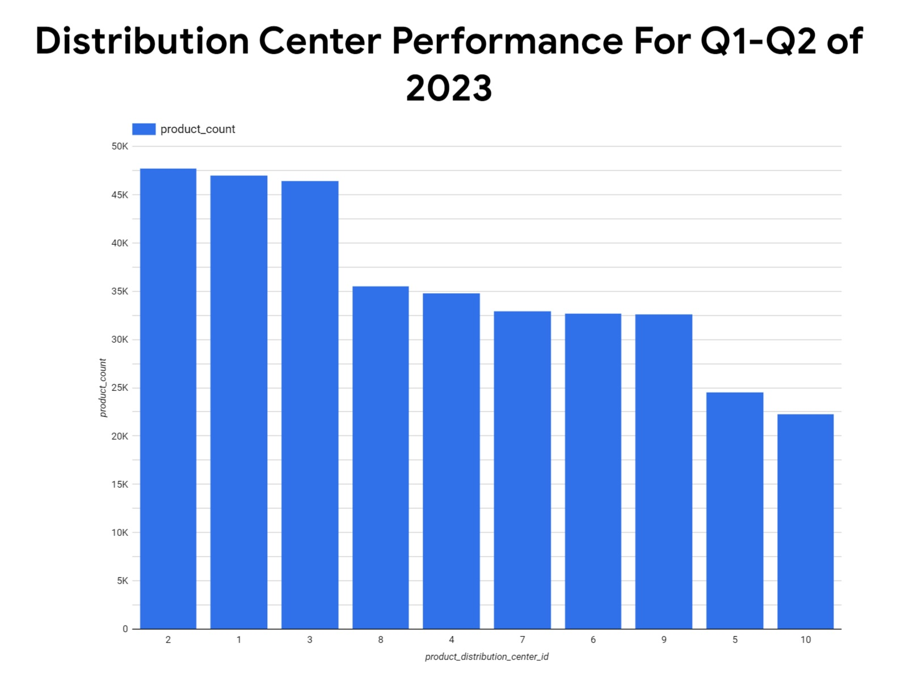
Distribution Performance
The top 3 distribution center are 1,2,3 that send around 45 thousand item for the Q1 and Q2 of 2023 show significant difference between the other center at around 30 thousand.

Slide 7
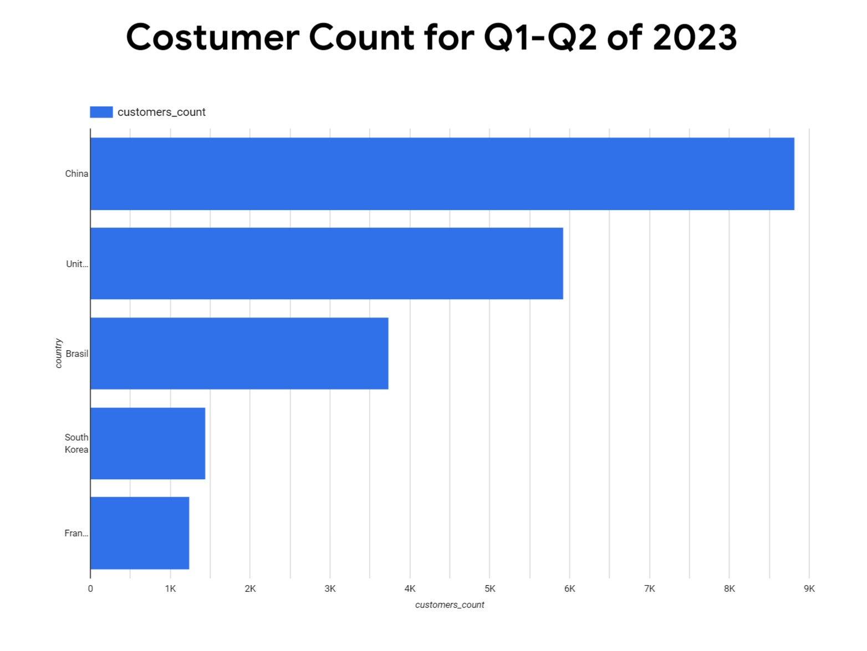
Global reach
As seen the highest number of order are to outside the countries especially China and Korea
For future global expansion we suggest into China because it is our biggest market and also can tap into Korea market which is also still in our top 5

Slide 8
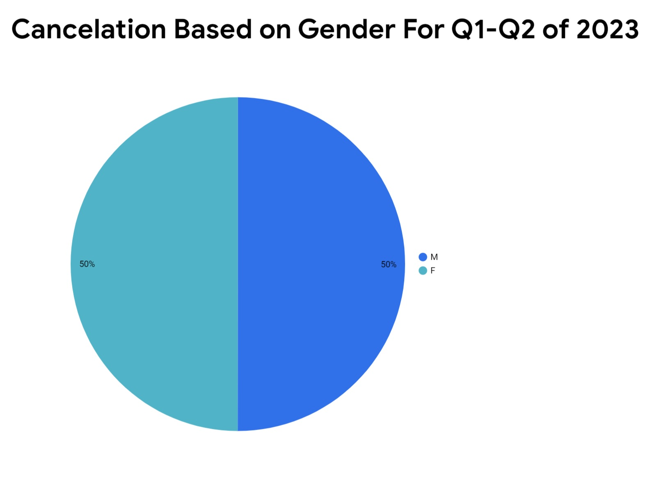
Gender
It shown that both male and female gender don’t show both have the same percentage of canceling their order.

Slide 9
Summary
In summary, the key points from the analysis of The Look's shipping and stock performance for Q1-Q2 of 2023 are:
Order Status Distribution: The completion rate is around 25%, while returns and cancellations combined also account for approximately 25%, indicating room for improvement compared to industry standards.
Top Shipped Categories: Intimates, Jeans, and Tops and Tees are the top three categories shipped, showcasing customer preference across a range of products. However, the gap between the top 10 categories is not significantly different.
Distribution Center Performance: Distribution Centers 1, 2, and 3 outperform others, shipping around 45,000 items, indicating the need for further examination and potential optimization of other centers.
Destination Countries: Orders shipped to countries outside the home market, particularly China and Korea, represent growth opportunities. Expanding further into China and leveraging the presence in Korea can tap into these markets.
Gender-based Order Cancelation: There is no significant difference in cancelation rates between male and female customers, suggesting cancelation decisions are influenced by factors beyond gender.

Slide 10
Thank You

